Slide 1
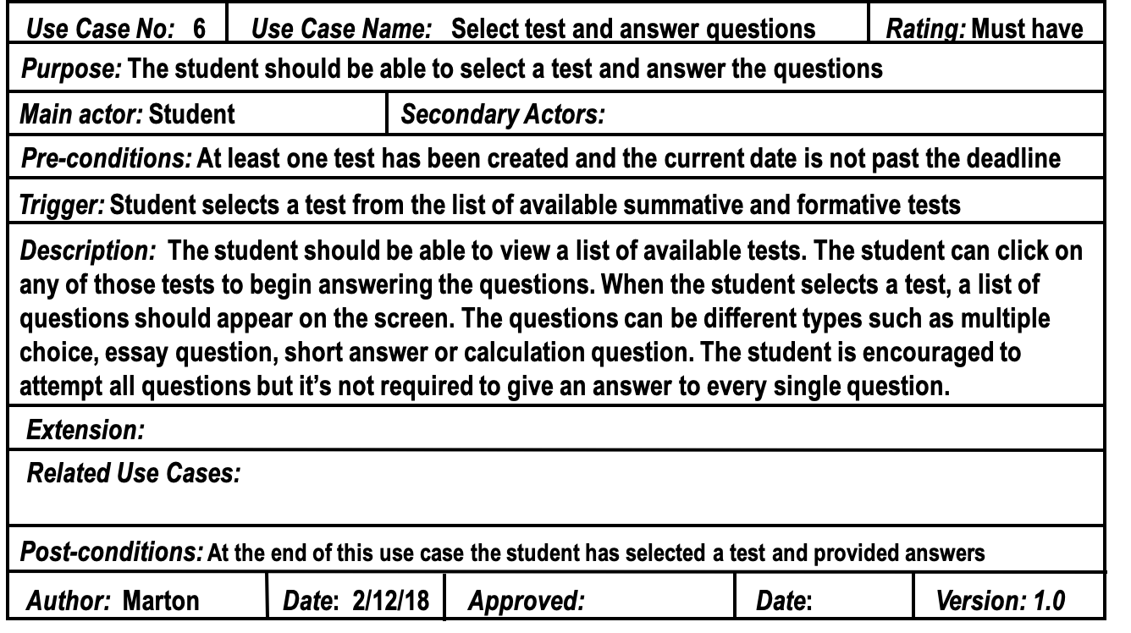
Detailed Use Case Template (Structured Natural Language)
Notes:
CMT303 Software Engineering, UML Part 1

